Slide 1
Bike Rental Analysis
Palak Malviya

Slide 2
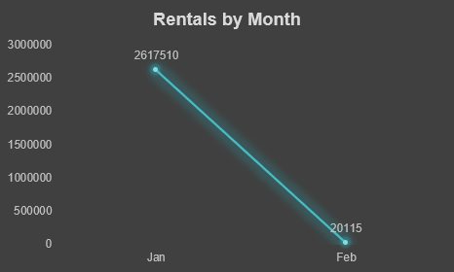
Rentals by Month
There is a significant drop in rentals from January to February .
January: 2,617,510.
February: 20,115 .
January peak performance :-
January Shows Very High Rental Activity, Indicating Strong Demand During That Period.
February unusually low :-
February Has Very Low Rentals, Which Is Not Normal Compared To January

Slide 3
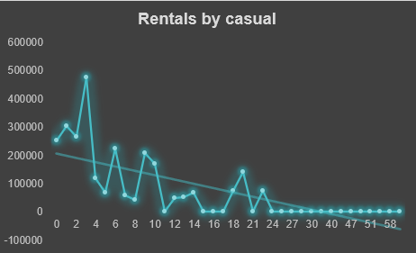
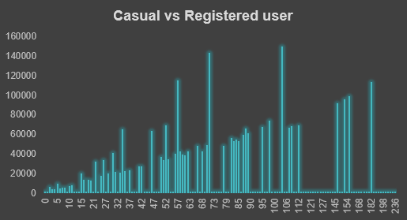
Casual vs Registered Users
Casual user vs registered user :-
Registered Users Contribute Significantly More Rentals Compared To Casual Users .
Casual Users Show Lower And More Fluctuating Usage.
Registered Users Show A More Stable And Consistent Pattern Over Time.
Most Of The Peak Values Are Driven By Registered Users.
The Business Relies Heavily On Registered Users, While Casual Users Contribute Less And Are More Unpredictable
“Registered Users Dominate And Are Consistent, While Casual Users Are Fewer And Unpredictable.”

Slide 4
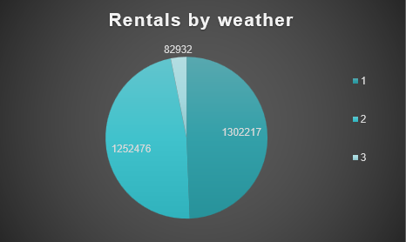
Rentals by Weather
The majority of rentals occur during clear weather conditions.
Weather Type 1 Has The Highest Demand:
1,302,217 Rentals
Users Prefer Bikes When Weather Is Comfortable And Clear
Rental demand slightly decreases during cloudy or misty weather conditions.
Weather Type 2:
1,252,476 Rentals
Demand Is Still High But Lower Than Clear Weather
Rental demand drops significantly during rainy or harsh weather conditions.
Weather Type 3:
Only 82,932 Rentals
Rain/Bad Weather Strongly Discourages Bike Usage

Slide 5
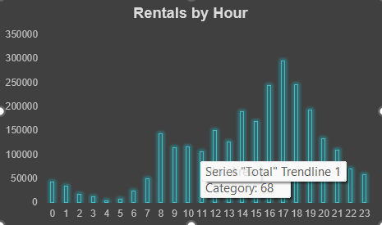
Rentals by Hour
The highest number of rentals occurs during evening hours, especially around 5 PM to 6 PM.
Around 17:00–18:00 (5–6 PM)
Rentals Reach Nearly 300,000
Rental demand starts increasing in the morning hours.
8 AM To 9 AM
Late-night and early morning hours show the lowest rental activity.
12 AM To 5 AM
“The Data Shows A Clear Commuting Pattern With Two Major Peaks — Morning And Evening.”

Slide 6
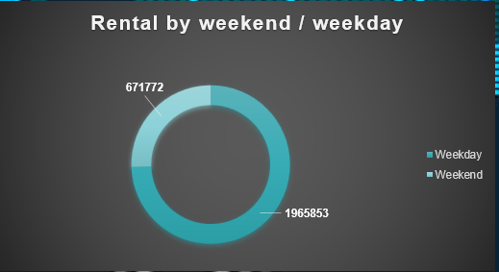
Rental by Weekend / Weekday
The majority of bike rentals occur on weekdays compared to weekends.
Weekday Rentals:
1,965,853
Weekend Rentals:
671,772
Most Users Rent Bikes During Working Days
Rental demand decreases on weekends, indicating lower commuting activity.
Weekend Usage Is More Casual Or Leisure-based
“Bike Rentals Are Significantly Higher On Weekdays, Showing Strong Office And Daily Commute Usage.”

Slide 7
Thank you

